Slide 1

Analyses of genome data
Maria Izabel Cavassim Alves

Slide 2
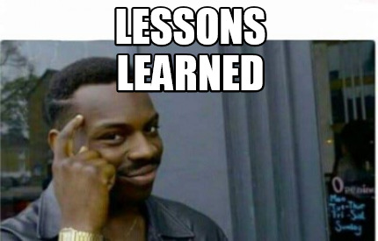
Recap of yesterday’s lecture and exercise
What have we learned so far?
https://docs.google.com/document/d/1F2k2Gw2NGMdCLOgfOTfXwpp6rFI9MYf7kCjIt1XgsJk/edit?usp=sharing

Slide 3
Day 3
Peer review of previous assignment (15 minutes)
Background lecture (45 minutes)
What is a copy number variant?
Break (15 minutes)
Hands-on exercise (1 hour and 30 minutes)
GWAS and population structure
Break (15 minutes)
Assignment explanation (15 minutes)

Slide 4
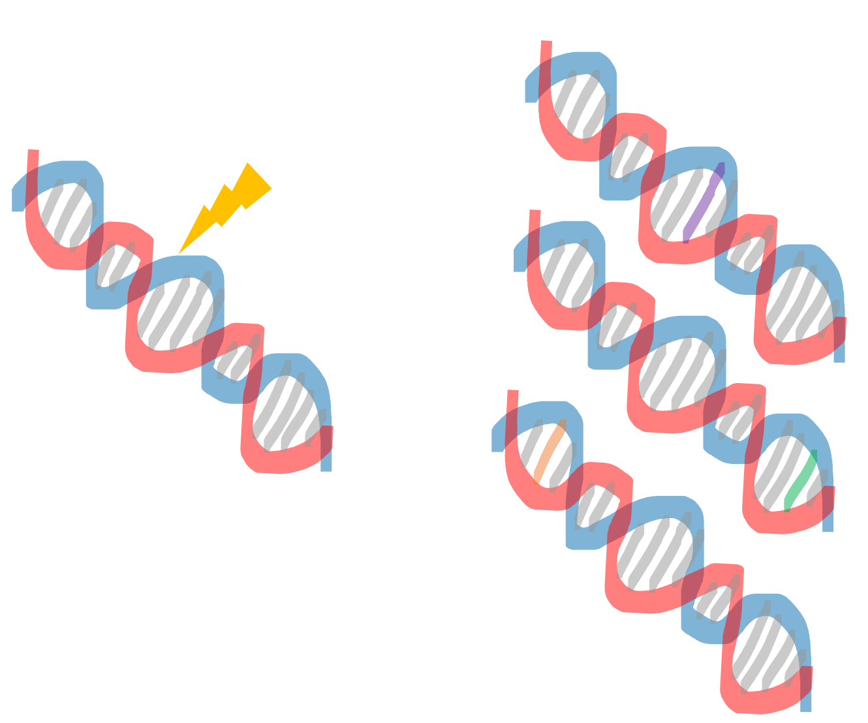
SNPs are not the only type of mutations!
Deletions,
Inversions,
Translocations,
Duplications
Also lead to change in DNA sequence and could be associated with disease risk

Slide 5
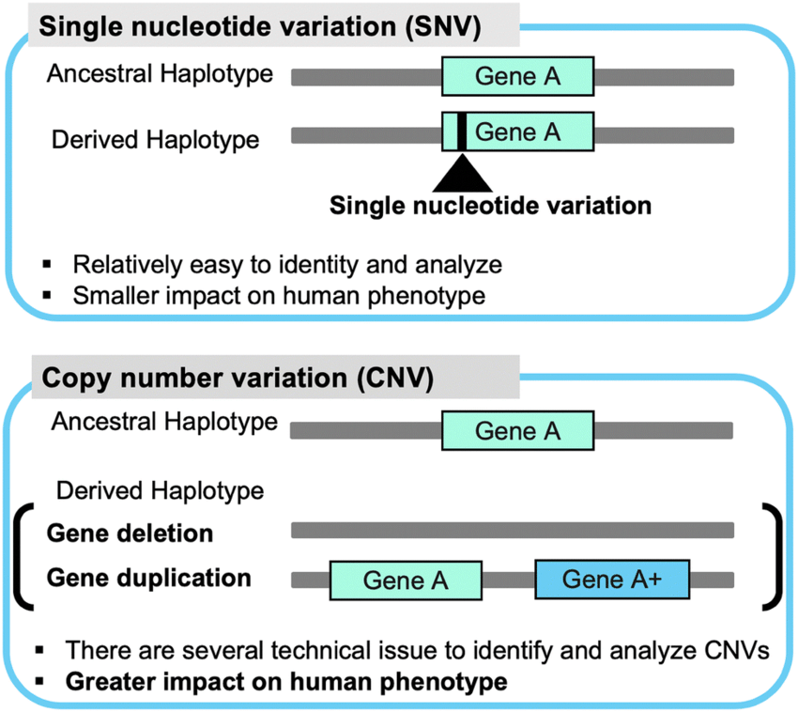
Saito and Gokcumen 2019

Slide 6
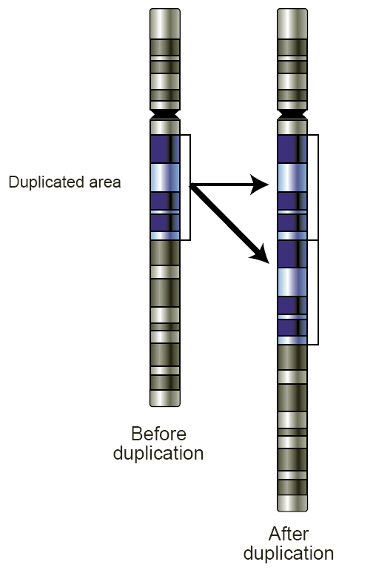
What is a Copy Number Variant (CNV)?
Copy number variation is a type of structural variation where you have a stretch of DNA, which is duplicated in some people, and sometimes even triplicated or quadruplicated. And so when you look at that chromosomal region, you will see a variation in the number of copies in population

Slide 7
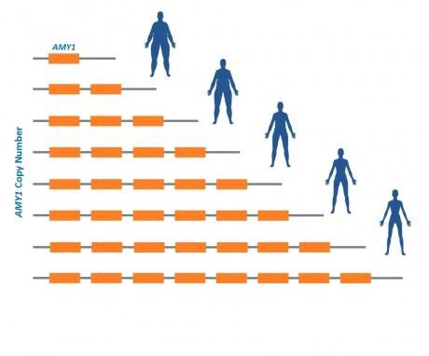
What is a Copy Number Variant (CNV)?
Source: Wikipedia

Slide 8
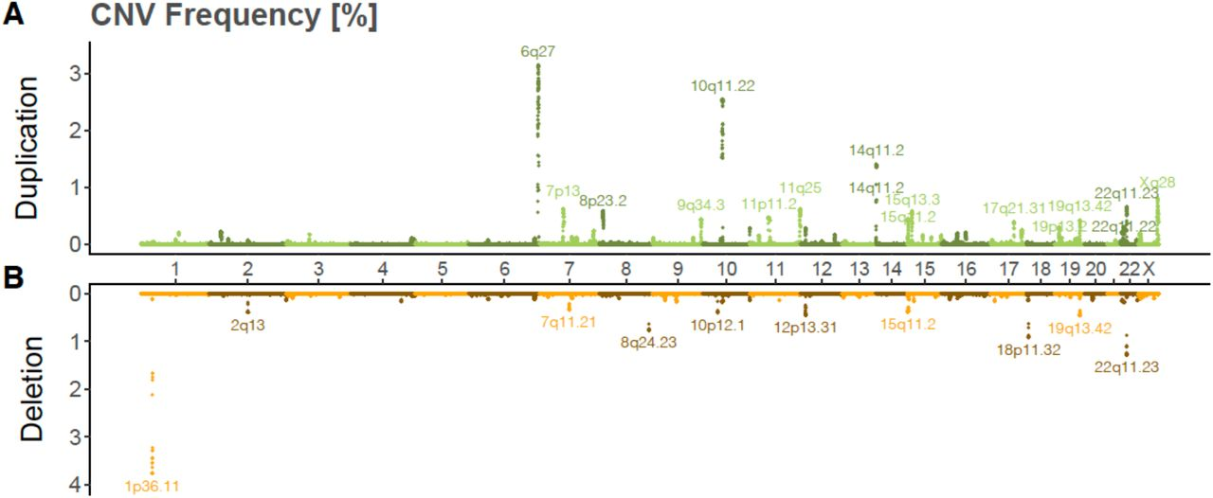
How frequent are deleterion vs duplications in humans?
Auwerx et al., 2021
deletion frequencies tend to be lower than duplication frequencies in UK Biobank

Slide 9
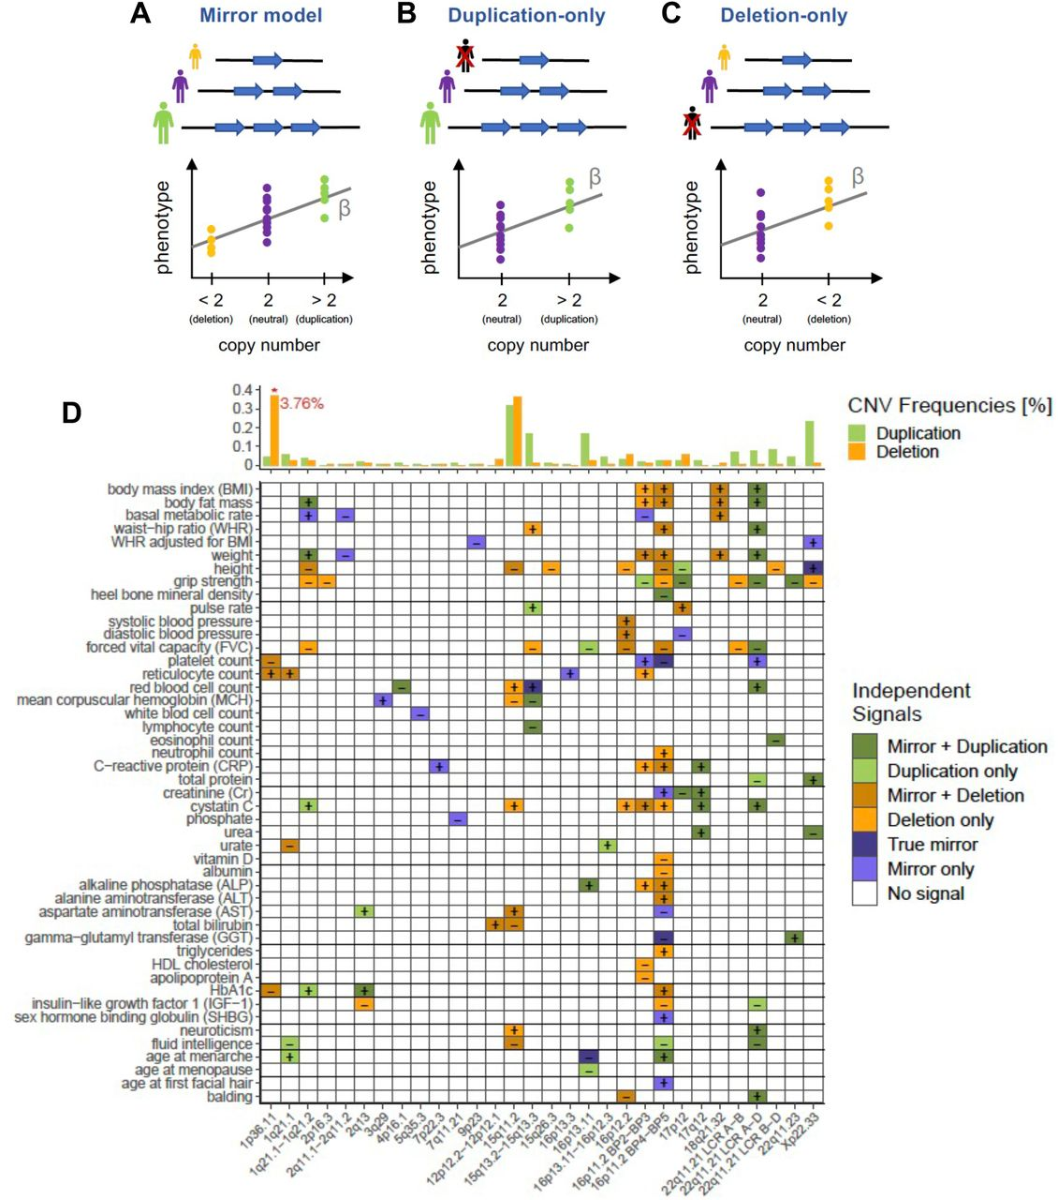
CNV-GWAS association models:
(A) The mirror model assumes an equal-sized but opposite-direction effect of deletion and duplication and estimates the impact of each additional copy number;
(B) The duplication-only model disregards deletion carriers and estimates the effect of a duplication;
(C) The deletion-only model disregards duplication carriers and estimates the effect of a deletion.
(D) Independent GW-significant associations between CNVRs (x-axis; as cytogenic bands) and phenotypes (y-axis). Colors represent the model(s) through which the association was detected
Auwerx et al., 2021

Slide 10
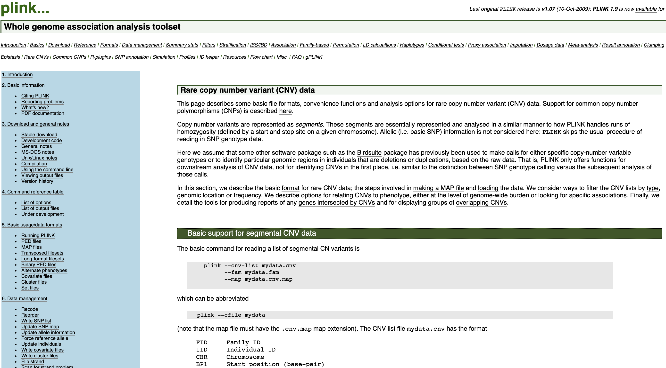
How to do GWAS of CNV with Plink?

Slide 11
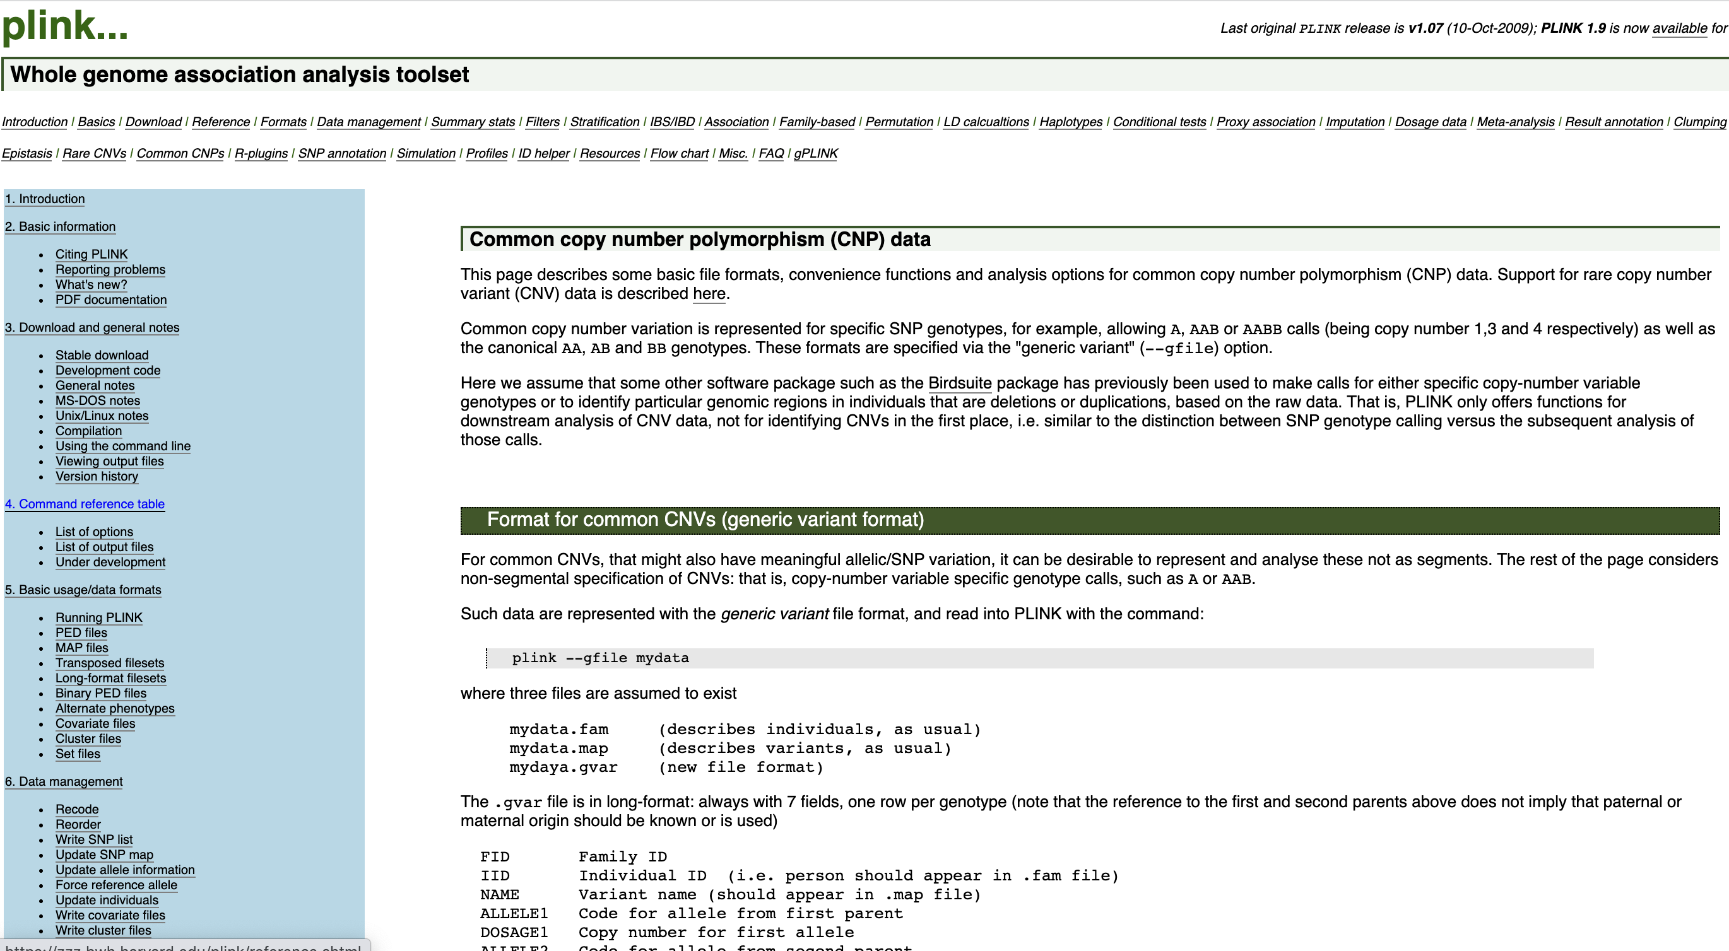
How to do GWAS of CNV with Plink?

Slide 12
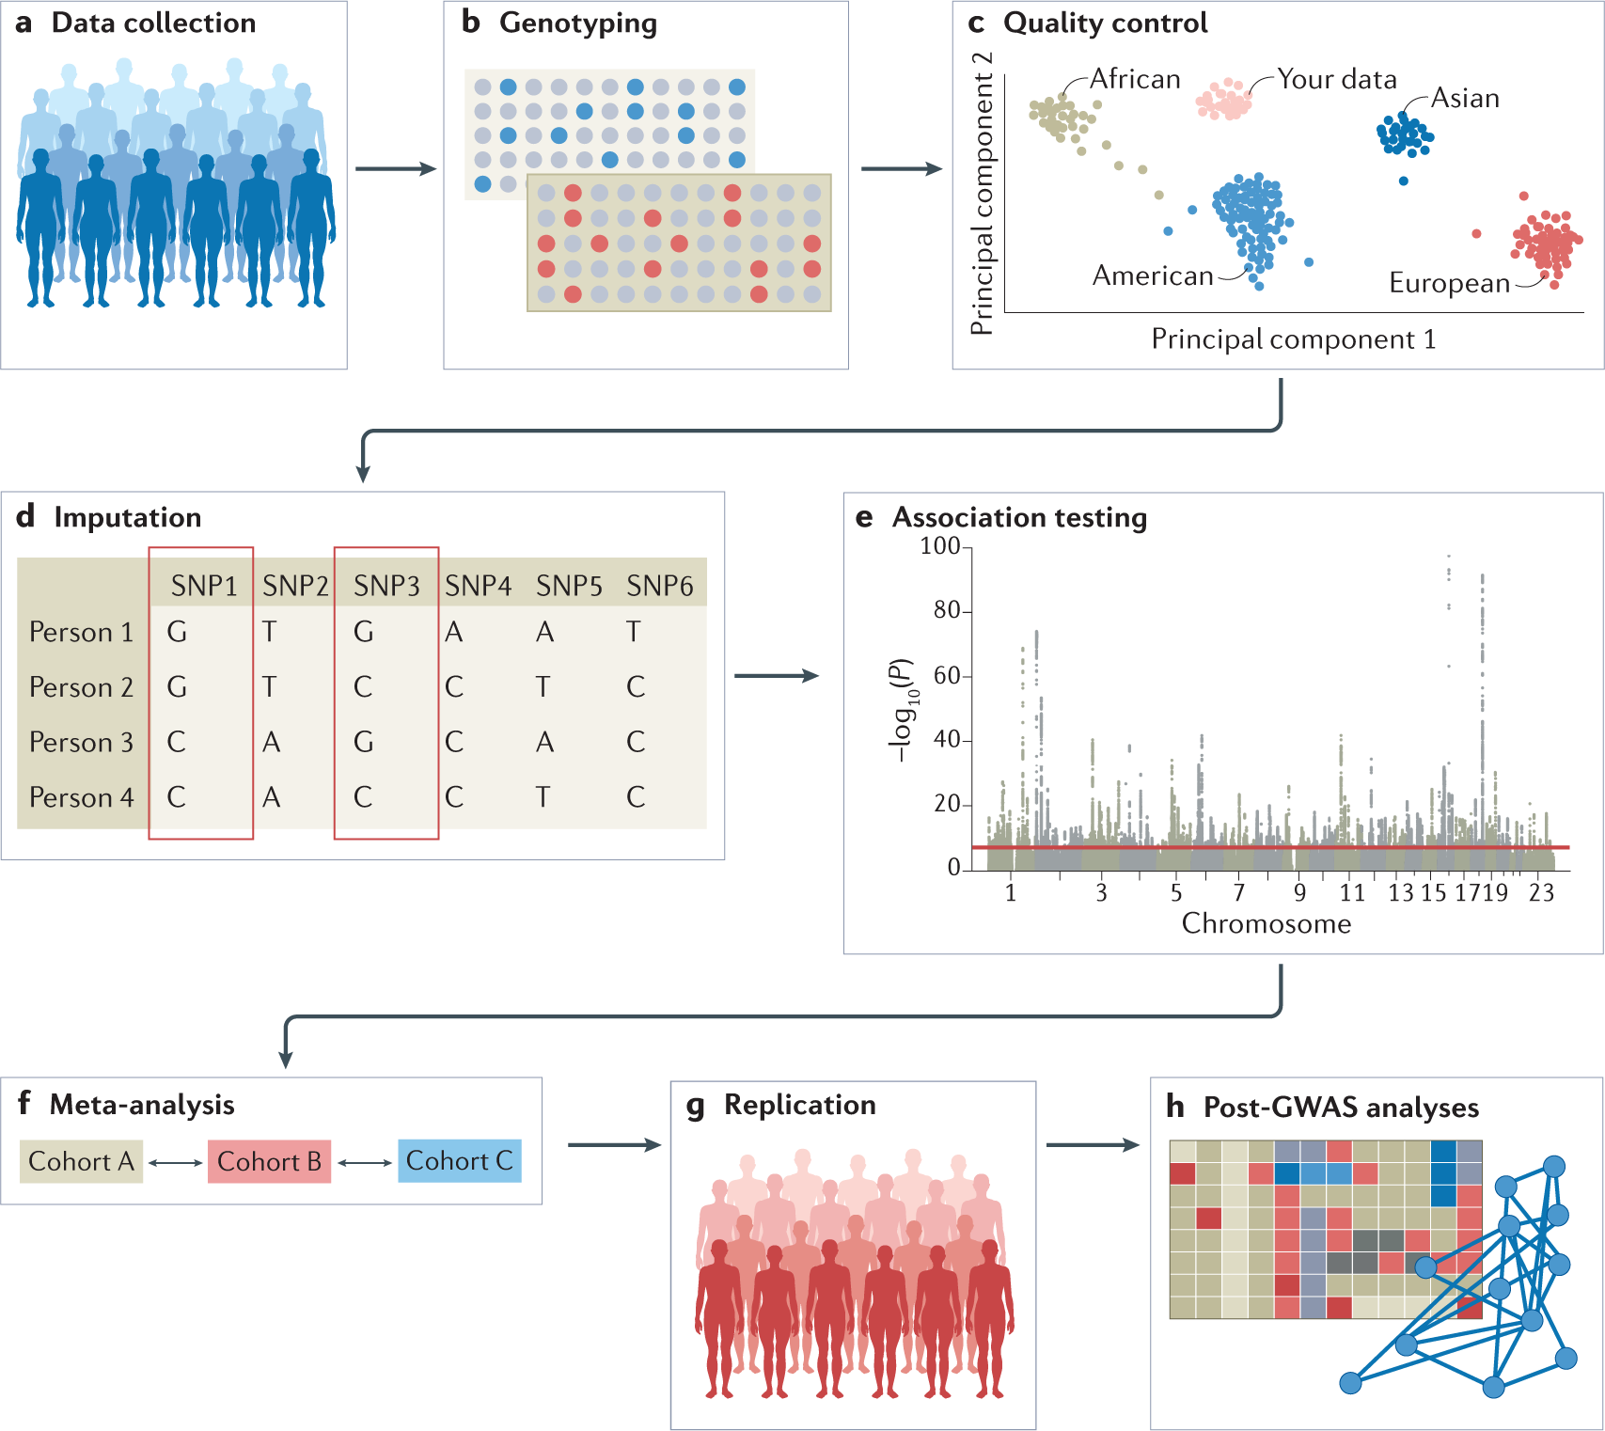
Recap of the workshop
There are inifity # of possibilities on how one could
tackle a specific problem/question!
This is the beauty and the danger of genomic data,
if the steps taken are well supported by others/literature,
then I believe you are on the right path!

Slide 13
Assignment 2 (GWAS and population structure)
To get started we need to:
Have Plink already
Have R and R studio installed on your machine
Download the R markdown version of the assignment here:
https://github.com/izabelcavassim/Analyses_of_genome_data/blob/main/Assignments/Assignment2.Rmd
For this exercise we will not work with the VCF format but the PLINK format, and you need to have the plink executable in the same folder as the datasets

Slide 14
Course evaluation
https://create.kahoot.it/share/workshop-evaluation/7c7093ec-630e-4988-9295-46dd3a30ca8f

